Slide 1
Twitter data Analysis
Competitive Performance of universities and improvements
SUBMITTED BY:
GARIMA SOOD

Slide 2




Selected four universities for analysis based on tweet counts and extracted 250k records
Universities
Primary Information Used
Followers: 46.2k
Tweets: 17k
Tweet text
Hashtags
Retweets
Date of tweet
Location
# Followers
# Messages
# lists
# Favorites
Verified
Followers: 235k
Tweets: 14.5k
Followers: 273k
Tweets: 19.4k
Followers: 107k
Tweets: 14.7k

Slide 3

Most influential twitter users based on message volume, follows and retweets
Media houses like The Economist, WSJ, Forbes, AP, HuffPost, XHNews, NewYorker, IndiaToday, HistoryToLearn, etc. are the most followed twitter accounts
Maximum number of retweets differ by college and university official handles along with the faculty, sports teams, and individual school handles get majority of retweets for that particular university
For Uchicago, twitter accounts under the names: Uchicago, NobelPrize, uchicagogsu, sofiaorden, haileysecretary, ChicagoMaroons, DivineCollinsJD, UChicagoMed, etc. have gotten maximum retweets in the past year
Going by the message volume, twitter activity is higher for individual unverified accounts as compared to the verified accounts
TheEconomist | WSJ | Forbes | AP | HuffPost | XHNews | ndtv | NewYorker
HistoryToLearn | IndiaToday | business | the_hindu | CoryBooker | DRJAMESCABOT | CNNnews18 | USATODAY
Reuters | realmadriden | UberFacts | FIFAcom | BabyAnimalsPic | NewYorker | SexLowkey | guardian
abpnewstv | BDUTT | CBSNews | businessinsider | FastCompany | EconomicTimes | Dev_Fadnavis | LarryFitzgerald
CNBC | xocult | CNBC | Notebook | distant | ScholarshipsUK | NPR | jorgeramosnews
MOST INFLUENTIAL

Slide 4
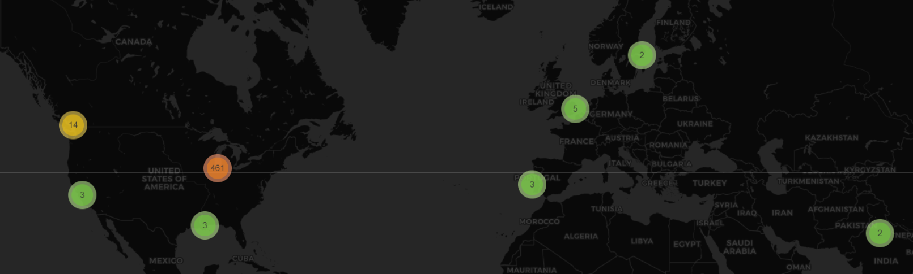
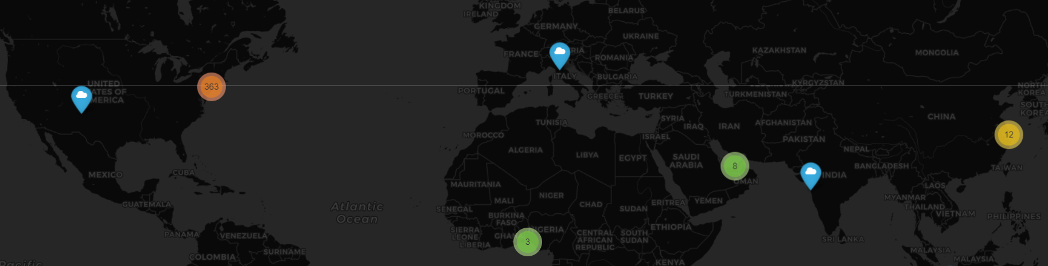
Location of authors for different univ. is ‘highly driven’ by the location of the university
Majority of the Tweets on UChicago generate from the Chicago region
Tweets on NYU and Columbia primarily generate from New York region in the US

Slide 5
How much are people tweeting about university vs. the other topics?
While the tweets that I worked on relate to the Universities given the filtering criteria, there is a variation in the topics tweeted about within and across universities:
UChicago:
Majority tweets are around Prof. Richard H. Thaler winning the 2017 Prize in Economic Sciences, and the quotes of Nobel Prize-winning economist Milton Friedman
Following this are the topics of homeworkhelp, graduate student union, and Dr. Georgiana Simpson
NYU:
Tweets with hashtag of #endjewishprivilege on representation of Jews in the universities, and
Action on NYU student with Albatross Killings charges, were most discussed
Columbia:
Gun violence and Devon (a doctoral student who lost his life to gun violence) were most tweeted
Cornell:
Robotics and augmented reality was the most tweeted topic at Cornell given their new advancement in this field: http://news.cornell.edu/stories/2018/02/augmented-reality-takes-3-d-printing-next-level

Slide 6
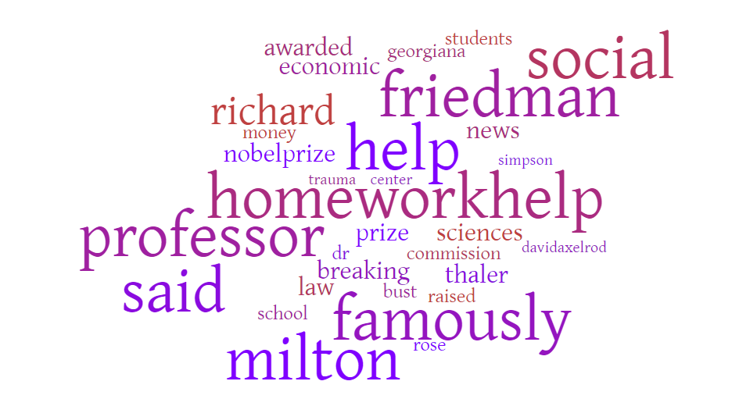
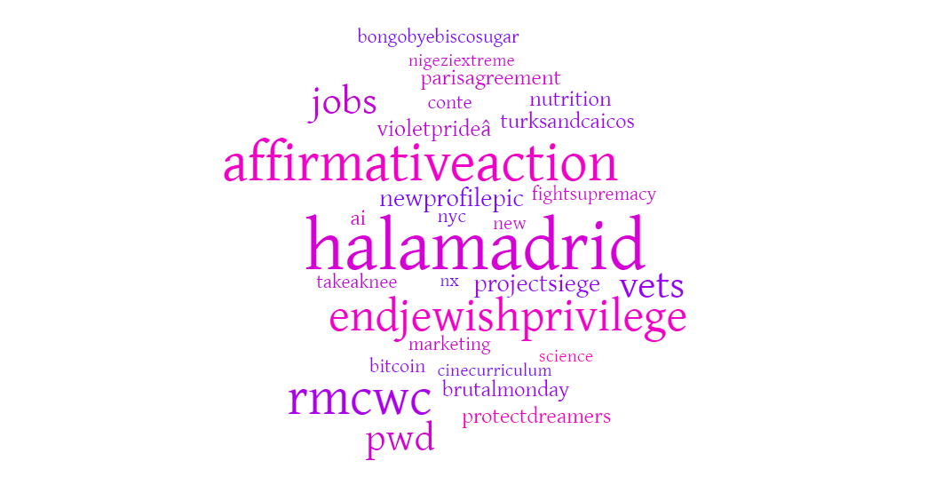
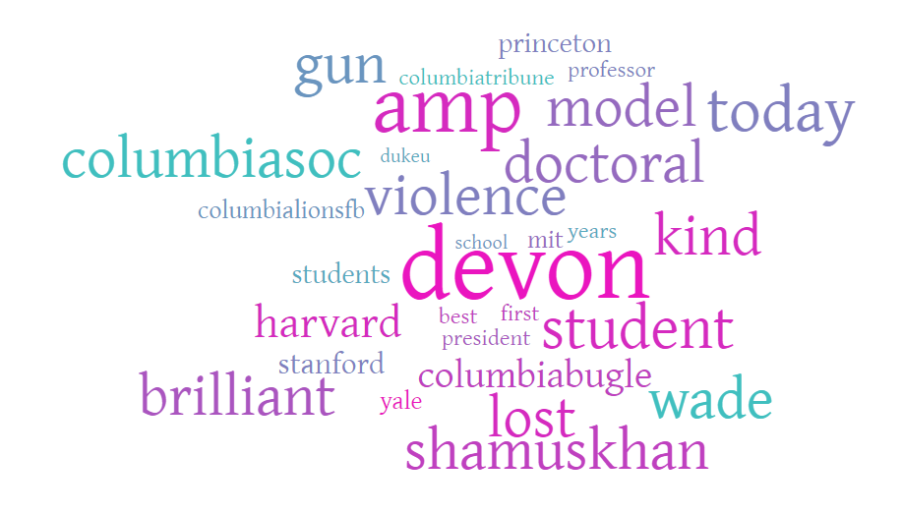
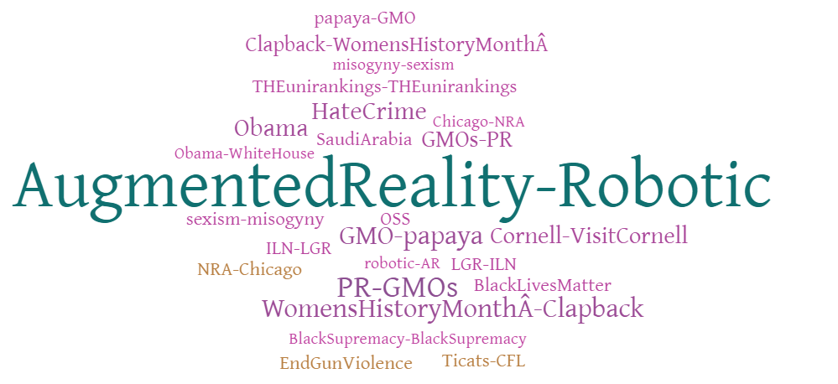
Word clouds of keywords show the diversity as well as local focus of tweets of/ on different universities
UChicago Tweets
NYU Tweets
Columbia Tweets
Cornell Tweets

Slide 7
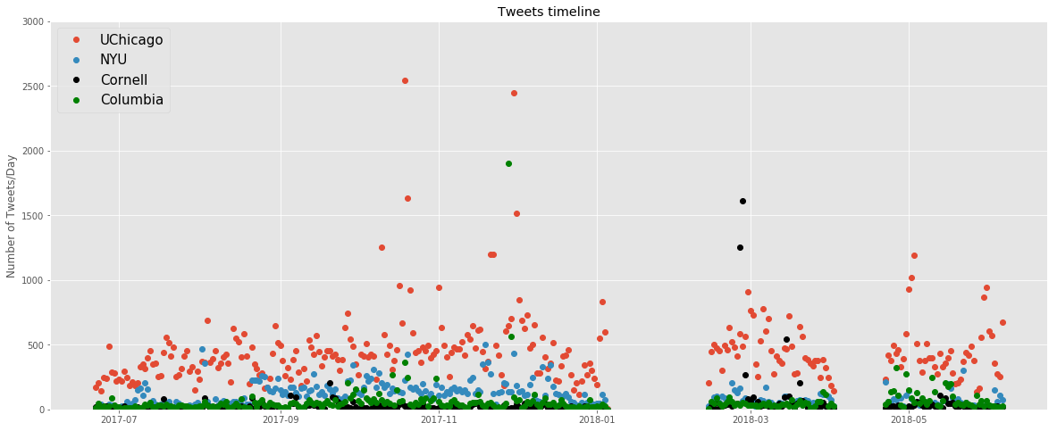
Timelines of the tweets
The tweets have been captured over one year from June 2017 to present with a clear gap in Jan, Feb and half of April in 2018 where the capture is zero:

Slide 8
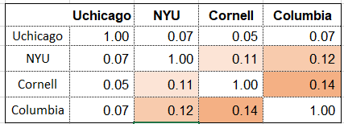
Uniqueness of tweets and recommendation for uchicago media strategy
Based on the Jaccard similarity, UChicago tweets are the well differentiated from tweets on other universities :
Recommendations:
Uchicago has only 46.2k followers which is significantly lower than NYU, Cornell, and Columbia, who have way more than 100k followers. While the twitter activity is similar, Uchicago should focus on improving its international presence as the location of tweets shows higher international activity on other universities
Cornell is actively tweeting about their innovations which has widely trended. UChicago should highlight its innovations more for enhanced visibility of infrastructure and achievements of the institution
UChciago’s tweets are primarily focused on academics right now. They can also talk about multicultural environment, sports, arts etc. to strengthen the impression of its all rounder and all embracing environments

